Slide 1
Slide00 Course Overview
CISC7201 INTRODUCTION TO DATA SCIENCE PROGRAMMING
Dr. Ryan Leong Hou U
Interim Head of Centre for Data Science (CDS)

Slide 2
Short Term Plan
Today go through our expectations and course plan
Briefly overview the data science background and applications

Slide 3
About me
Who am I?
Dr. Ryan L.H. U
A faculty member in CIS
Office: E11-4021
Phone: 8822-4493
ryanlhu@umac.mo
Office Hours
Tuesday 11:00-12:00 a.m.
Thursday 11:00-12:00 a.m.
Or by email appointment
TA
We will have a teaching assistant but I am not sure who will take this job…

Slide 4
Communications
Via UMMoodle
There is a forum for discussion
By Email
In general, I will reply an email in 1~2 hours (only if your emails are sent in working hours.)

Slide 5
Reference books

Slide 6
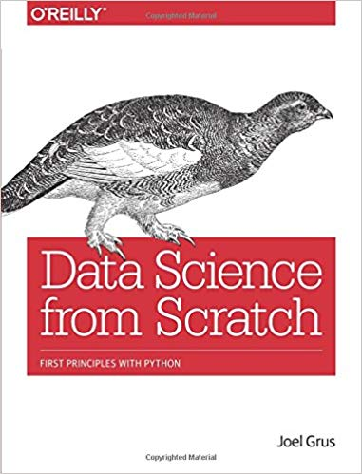
Data Science from Scratch
Joel Grus

Slide 7
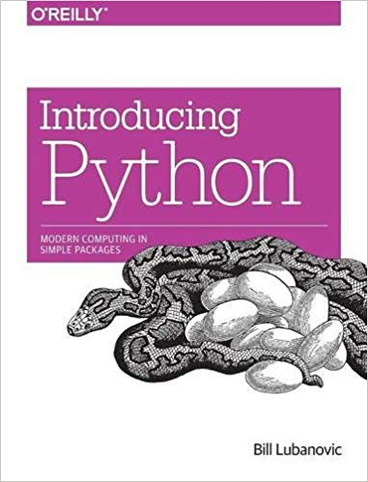
Introducing Python: Modern Computing in Simple Packages
Bill Lubanovic

Slide 8
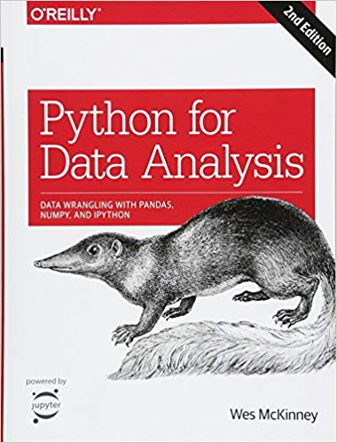
Python for Data Analysis: Data Wrangling with Pandas, NumPy, and IPython
Wes McKinney

Slide 9
Course Work

Slide 10
Regular meetings
Lecture & Tutorial classes
Monday (weekly)
19:00 - 22:00 @E12-G003(L)
You need to attend every class. Some inclass exercises / quizzes will be given without prior notice.

Slide 11
Assessments (tentative)
Read & Listen
Course slides
Textbooks
Tutorials
Practices
5+++ written & programming Assignments (30%)
1-2 written projects (30%)
Exams
1 final (40%)

Slide 12
Policy on Collaboration
Assignments/projects/summaries:
Work on project independently:
No direct sharing of questions/codes
No line-by-line assistant
No exchange of answers/codes
You are encouraged to ask questions of one another, and to respond to other student's questions (and especially on the email list)
Exams:
Closed-book but 1~2 cheat sheets are allowed.
No make-up tests unless absence is due to serious illness.
Doctor’s diagnostic note is required. The final grade will be scaled accordingly.

Slide 13
Late Submission Policy
If [Less than 24 hours]
Deduct 20% of the mark
Else If [Less than 48 hours]
Deduct 50% of the mark
Otherwise
Deduct 100% of the mark
Please start your assignment as soon as possible. In case you meet any problems of the assignment, you are welcome to consult me and the tutor.

Slide 14
Expectation of this course

Slide 15
At the end of this course, you should be able to understand the following topics.
Understanding of Data Science
1 week
Crash course in Python
2-3 weeks
Basic libraries in Python
Visualization
Linear Algebra
Statistics
Probability
Gradient Descent
Getting Data
Working with Data

Slide 16
If time is permitted, you will be able to have some ideas of the following topics.
Distributed Data Processing
MapReduce
Hadoop
Spark
Machine Learning
Nearest neighbors
Linear Regression
Logistic Regression
Decision Trees
Neural Networks
Clustering
Recommendation Systems

Slide 17
Topics not covered in this Course
Simply use some existing tools to complete some easy-to-solve data processing / analytical problems

Slide 18


